Slide 1
IMM 120 / CSC 101
Welcome!

Slide 2
My Name is Chris Hallberg
crhallberg@gmail.com
Office: To the right of the IMM office
Office Hours: 11am until class every Monday, online too!

Slide 3
Before we get started…
How many of you have a laptop?
We may be moved to a new classroom with fewer computers.

Slide 4
Today
Learn about the class.
Talk about learning how to program.
Make a terrible sandwich.
Look at some resources.

Slide 5
Learning to Program
“All programmers are playwrights and all computers are terrible actors.”
~ Anonymous
“Computers are fast, not smart”

Slide 6
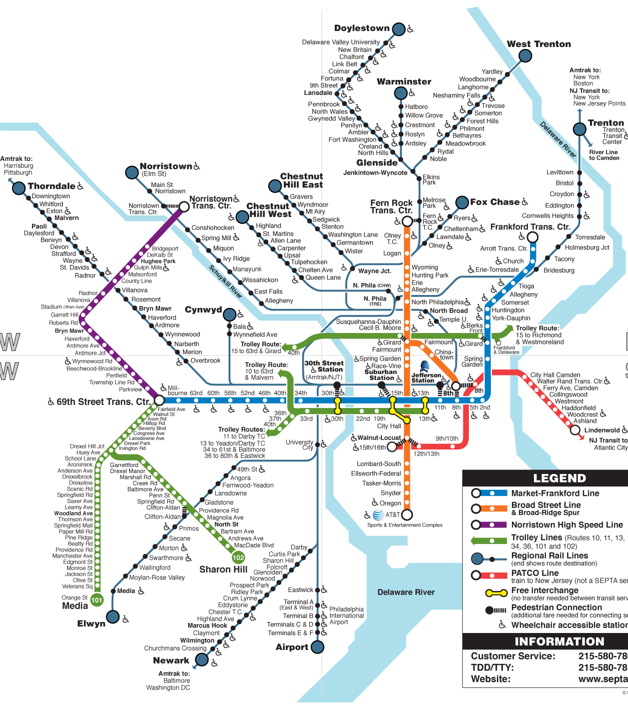
What it’s like to Learn Programming
Learning a foreign language
All code will be in English, but the grammar and punctuation are wild!
Learning to think algorithmically
Breaking problems down into steps
Organizing those steps optimally

Slide 7
Things We Will Run Into While Coding
Math!
Particularly basic algebra and trigonometry.
This math will be easy and/but non-linear.
x = y + 10
x = (i * 100) + 10
You’ve been warned.
Color theory
Interface design
Data organization

Slide 8
What is it like to Program?
You will often be surprised by what is easy and what is hard.
Notes:
“difficult” -

Slide 9
For example: Doors
Can the player open them?
Can the player open every door in the game? Or are some doors for decoration? How does the player know the difference? Can doors be locked and unlocked?
What tells a player a door is locked and will open, as opposed to a door that they will never open?
Does a player know how to unlock a door? Do they need a key? To hack a console? To solve a puzzle? To wait until a story moment passes?
Where do enemies come from? Do they run in from doors? Do those doors lock afterwards? Are there doors that can open but the player can never enter them?
How does the player open a door? Do they just walk up to it and it slides open? Does it swing open? Does the player have to press a button to open it? Do doors lock behind the player?
What size is a door? Does it have to be big enough for a player to get through?
What about co-op players? What if player 1 is standing in the doorway – does that block player 2?
What about allies following you? How many of them need to get through the door without getting stuck?
What about large enemies? Do enemies that are larger than a person also need to fit through the door?

Slide 10
For example: Cooking
Follow a series of steps: “algorithm”
Room for expression.
You will be learning to right recipes for a chef that follows everything to the letter.
You will need to explain unique things (make the icing blue), but not common things (mixing, dividing, sorting).

Slide 11
For example: Sandwiches
This is going to be silly
Does anyone have a peanut allergy?

Slide 12
A Little Vocabulary
Command: turn the lid of the jar
Conditional: a yes/no question (is the lid of the jar open?)
Function: a series of smaller actions under one name (spread)
Call: to use a function, by name, sometimes with information (spread the jelly)
Line: a line of code, can contain several of the above
Parentheses: ( ) – opening and closing
Braces: { } – I will call these “brackets” or “curly brackets”
Bracket: [ ] – “square brackets”
Notes:
Opinions and differences: spoon vs knife for jelly.
Code style.

Slide 13
Javascript
Why Javascript?
One of the most widely used languages (https://githut.info/)
Available in many environments (web, scripting, server)
Very forgiving or “high-level”
You already have everything you need to get started

Slide 14
p5.js
A Javscript library built for artists in Java, later ported to Javascript.
Quick and easy visuals.
Inclusive community.
Online editor: https://editor.p5js.org.
This will be our primary coding environment for class and assignments.
Take a few minutes now to make an account so you can save your work and send me links for questions or assignments.
If you’ve coded before and you want to try Java or Python: https://processing.org.

Slide 15
A Quick Tour of p5.js
https://editor.p5js.org

Slide 16
Resources
There is no textbook for the class
Here are a few good books if you’d rather have something:
Make: Getting Started with p5.js
by Lauren McCarthy (creator of p5.js)
JavaScript: The Good Parts
by Douglas Crockford
The Nature of Code
by Daniel Shiffman (online)

Slide 17
Resources
Internal to Class
Write-ups on Canvas
Email me with a link to your project
Class sketches: https://editor.p5js.org/crhallberg/sketches
External
p5.js reference page: https://p5js.org/reference/
Daniel Shiffman’s YouTube Channel

Slide 18
About the Class
Time for the fine print

Slide 19
September 4 | Intro and Syllabus
September 10 | Drawing on a Screen
September 17 | Variables, Conditionals, Motion
September 24 | Events and Interactivity, Collision Detection
October 1 | Media (Images and Sound)
October 8 | Networking
October 15 | Fall Break
October 22 | Midterm Project
October 29
November 5 | Loops
November 11 | Arrays / Lists
November 18 | Flex
November 25 | Final Project Period
December 3
TBD

Slide 20
Week By Week
Review
Questions
Instruction
Hands-On
Minute Survey
The class is a 4-hour block. I will likely not fill the whole time. I always stay until 9 for any questions, comments, etc. BYO caffeine.

Slide 21
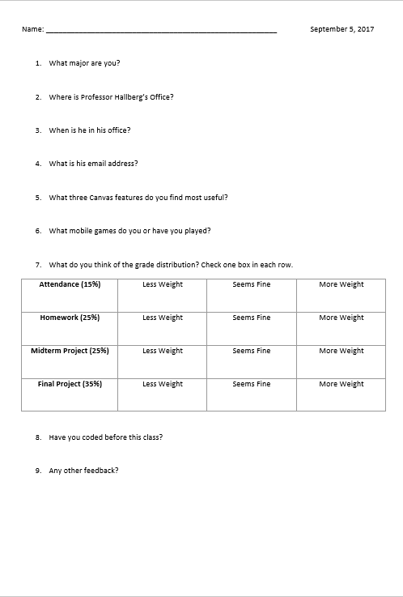
Minute Surveys

Slide 22
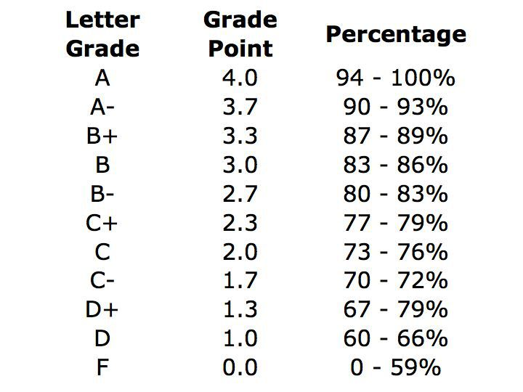
Grading
Your final grade will consist of:
20% for participation
20% for homework
25% for your midterm project
35% for your final project

Slide 23
Accommodations
Assignment extensions | More than a day’s notice if possible.
Missing class | Please let me know ahead of time.
Special Accommodations | Turn them in with your minute survey, talk to me after class, or email me in the next week.

Slide 24
Homework
Nothing really.
Keep an eye out for interactive articles or web pages
Nicky Case is amazing: https://ncase.me/
Voter maps on articles
Speaking of voter maps, please register to vote:
I Will Vote: https://iwillvote.com/
The Deep End: “What is Code?” by Paul Ford
Great article about being a programmer and history of coding
This is the longest article you’ll ever read

Slide 25
Minute Survey
Getting to know you

